Slide 1




What’s QEC to Solid State Physics
David DiVincenzo
17.12.2014
QEC14
Notes:
Prospects for superconducting qubits
I will give an overview of my work in a team of researchers at IBM on achieving highly coherent two level systems (qubits) in superconducting Josephson-junction devices. I will review the basic phenomenology that makes coherence possible, and discuss the startling progress in reducing decoherence in these systems. I will end with concepts for coupling arrays of qubits coherently to make a fault-tolerant quantum computer.
Should have more of basic circuit theory
Title: Scalable Scheme for Multiqubit Parity Measurement
Abstract:
Error correction for quantum computation is envisioned to involve local interactions in a two-dimensional structure, with frequent measurement of ancillas to acquire syndrome information. Since cavities are involved both in mediating the necessary quantum gates and in enabling the measurement, we have investigated how both functions can be accomplished in one step, and how ancilla qubits can be dispensed with. This single step is non-demolition measurement of a multi-qubit parity. The measurement is accomplished by using a microwave tone to interrogate the scattering phase shift of a resonant structure with multiple, closely spaced resonant modes, each coupled dispersively to the set of qubits whose parity is to be determined. I will show an explicit concept for an implementation with 3D cavities; almost cubical cavities would give the necessary near-degeneracy of modes.
I will begin with the basic concepts of how a two-state quantum system can be treated as a carrier of information, and will discuss some of the unique capabilities that it should have -- I will show one example, unforgeable quantum money. The basic idea that these "qubits" can be manipulated to do logical operations leads to algorithms whose efficiency is unachievable in a classical world. I will mention some of the remarkable facts about Shor's prime factoring quantum algorithm. I will continue with considering the prospects for the physical implementation of these machines. Clear progress is being made using several approaches, I will detail the recent steady progress in the area of superconducting quantum devices, with the real prospect of functioning multiqubit systems in the next few years.

Slide 2
Outline
Surface codes everywhere (and even color codes)
Various rough approximations of scalability
Attempting to get error & leakage rates under control – example from quantum dot qubits
The highly complex classical world of surface codes – example from UCSB/Google
Outside the gate model – one-shot syndrome measurement
Inside the gate model – Fibonnaci anyons

Slide 3
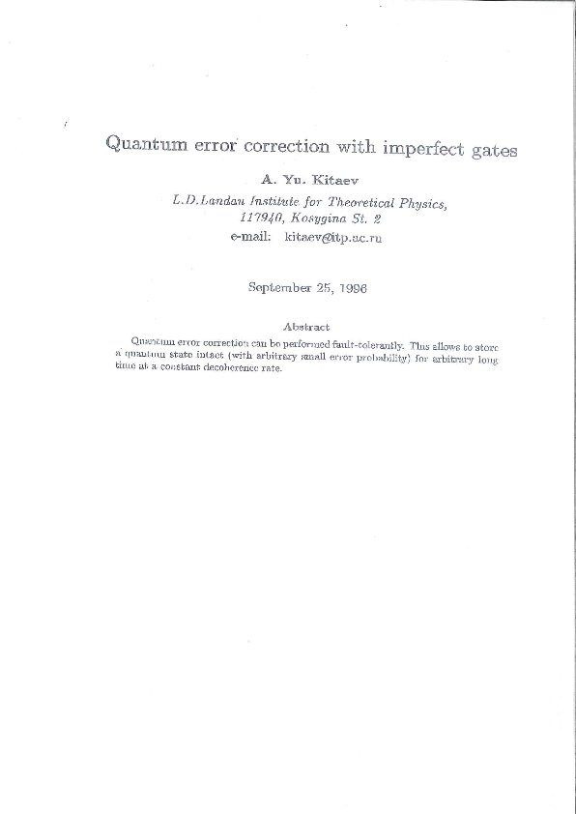
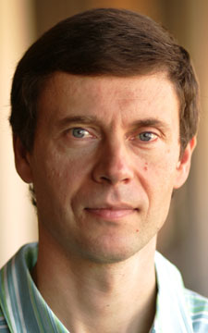
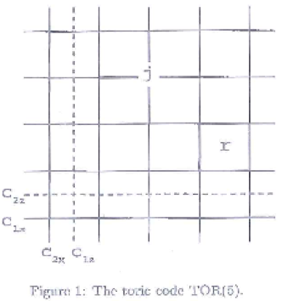
A development of 1996-7:
X
X
X
X
In Quantum Communication, Comput-
ing, and Measurement, O. Hirota et al., Eds. (Ple-
num, New York, 1997).
Z
Z
Z
Stabilizer generators XXXX, ZZZZ;
Stars and plaquettes of interesting
2D lattice Hamiltonian model
Z
Toric Code/Surface Code

Slide 4
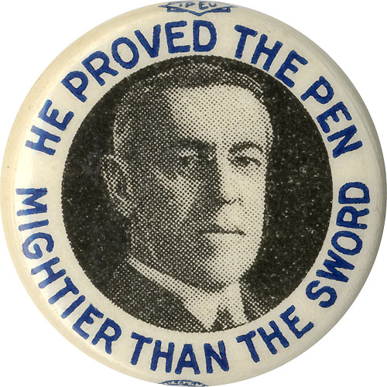
A development of 1996-7:
X
X
X
X
In Quantum Communication, Comput-
ing, and Measurement, O. Hirota et al., Eds. (Ple-
num, New York, 1997).
Z
Z
Z
Stabilizer generators XXXX, ZZZZ;
Stars and plaquettes of interesting
2D lattice Hamiltonian model
Z
Toric Code/Surface Code

Slide 5
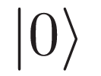
Surface code
Colorized thanks to
Jay Gambetta and John Smolin
Q
Q
Q
Q
Q
Q
Q
|0
|0
Q
Q
Q
Q
Q
Q
|0
Q
Q
Q
Q
Q
Q
Q
Q
Q
|0
Q
|0
|0
Q
Q
Q
Q
Q
Initialize Z syndrome
qubits to
One level of abstraction – CNOTs on square lattice with data qubits (blue) and ancilla qubits (red and green)

Slide 6
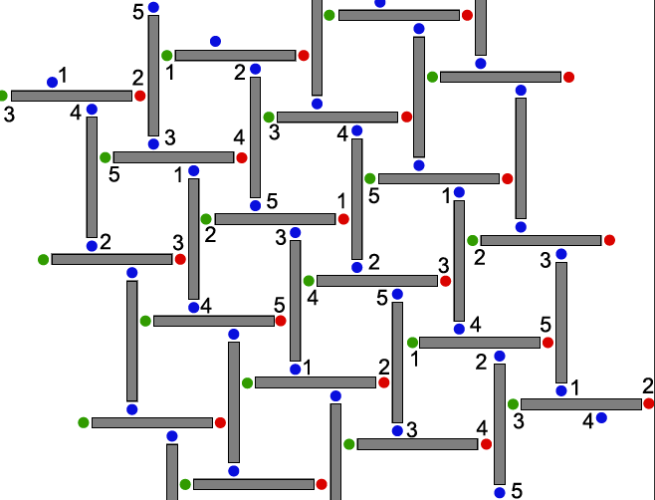
Slightly less abstract – geometric layout of qubits & couplers to implement desired square lattice
Blue: data
Red/green: ancilla
Numbering: qubits with distinct transition frequencies

Slide 7
“Realistic” chip layout of qubits and resonators
Qubits (green) coupled via high-Q superconducting resonators (gray)
“skew-square” layout of qubits and resonators is one way to achieve abstract square
Every qubit has a number of controller and sensor lines to be connected to the outside world (gold pads)
DP. DiVincenzo, “Fault tolerant architectures for superconducting
qubits,” Phys. Scr. T 137 (2009) 014020.

Slide 8
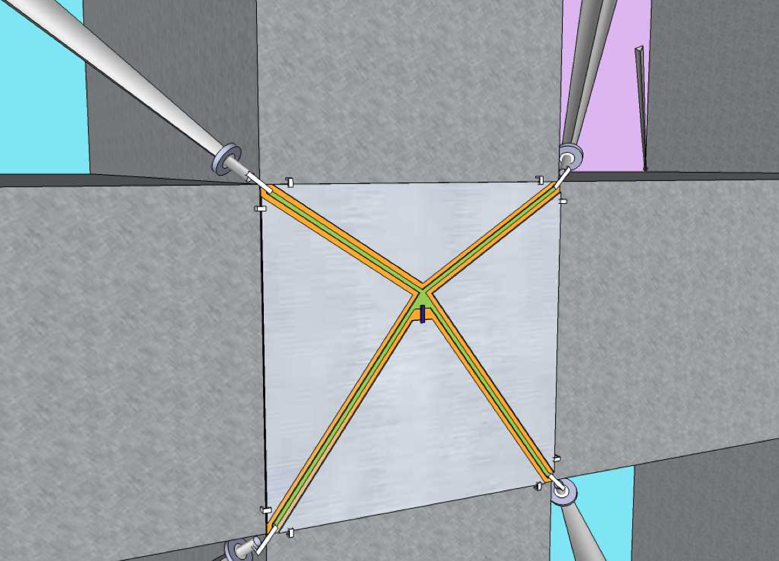
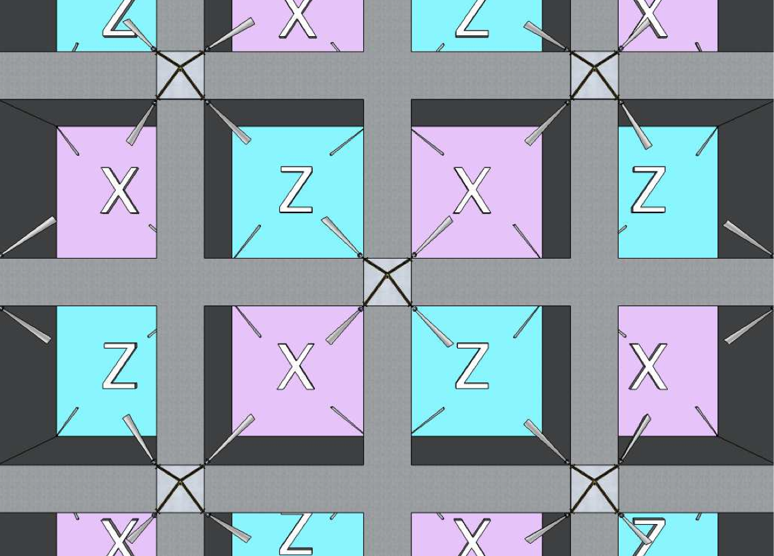
Another “Realistic” surface code layout in 3D circuit-QED architecture
Syndrome measurements without the execution of a quantum circuit
DiVincenzo & Solgun, New J. Phys. 2013

Slide 9
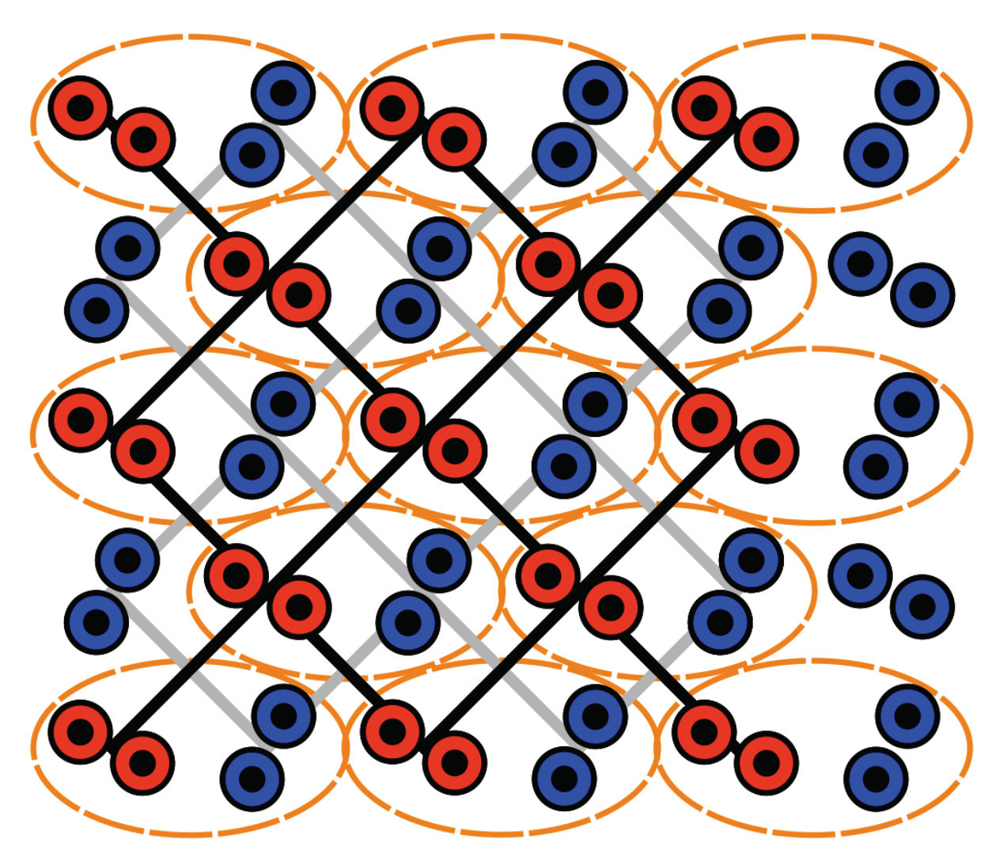
Another “Realistic” surface code layout for double-quantum-dot qubit
Mehl, Bluhm, DiVincenzo “Fault-Tolerant Quantum Computation for Singlet-Triplet Qubits with Leakage Errors,” in preparation

Slide 10
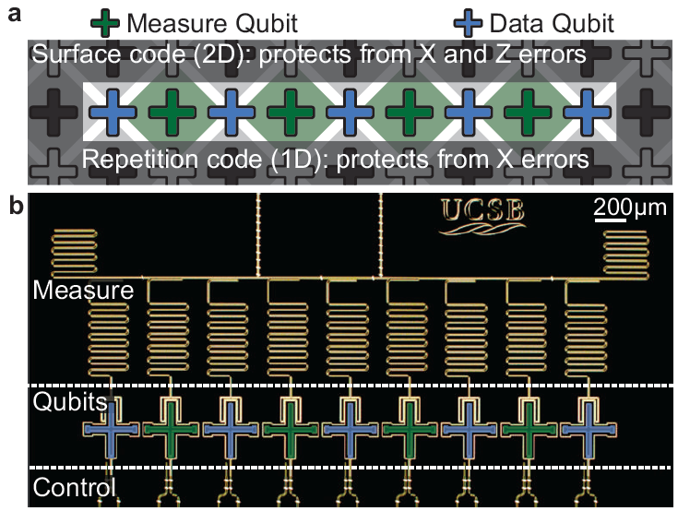
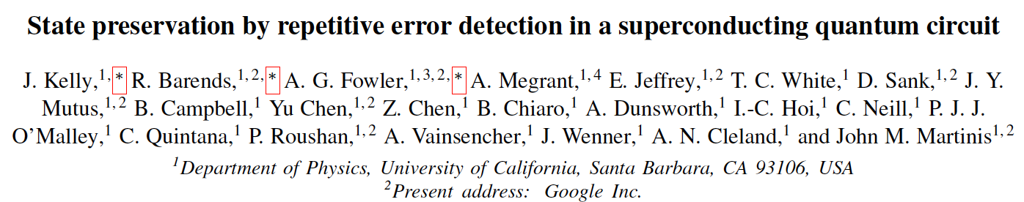
arXiv:1411.7403

Slide 12
Not obvious that this is a scalable implementation

Slide 13
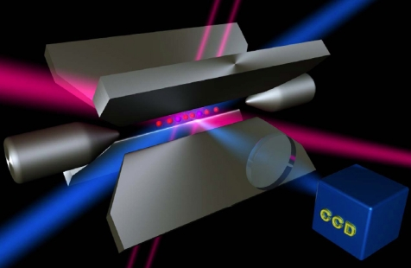
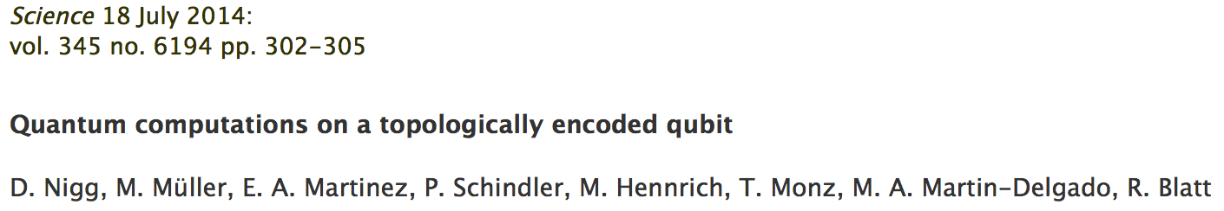
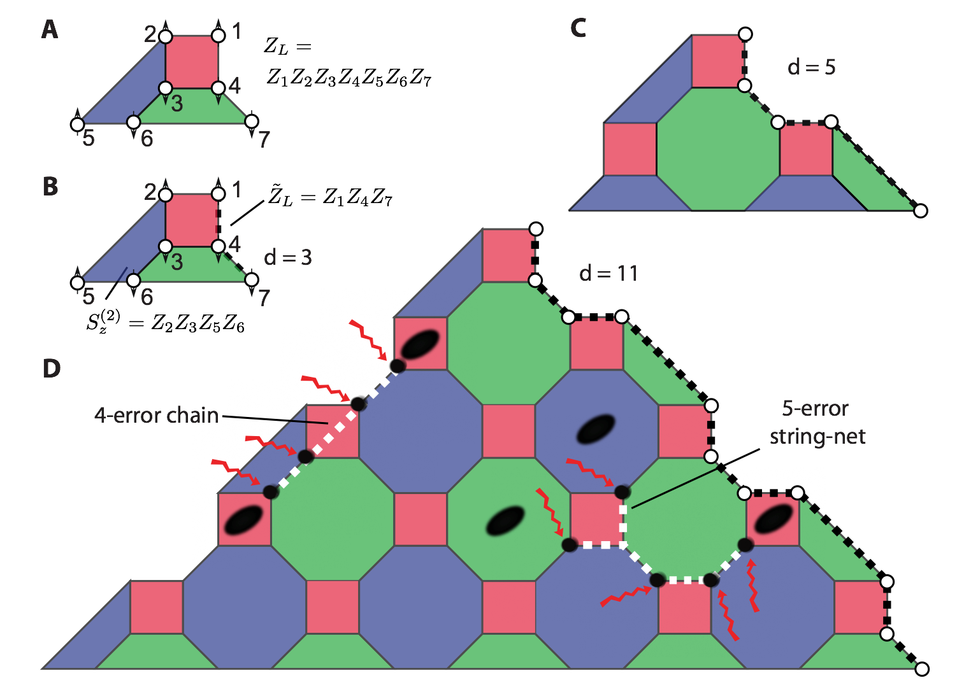
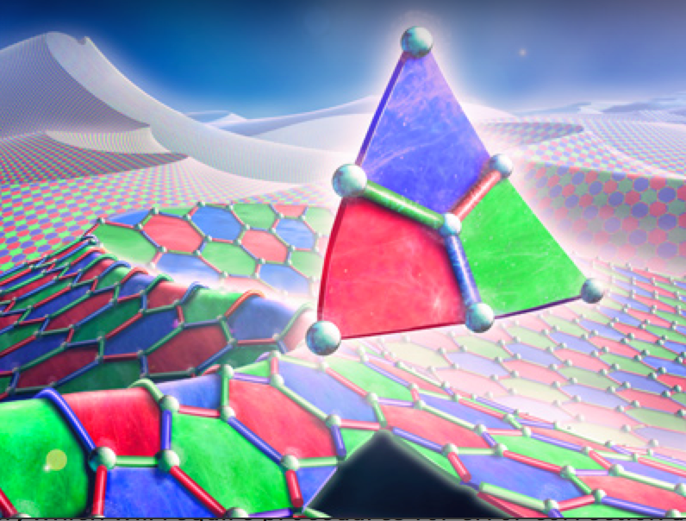
Progress error correction in ion traps,
But another not-really-scalable setup
Fig. S4
Steane 7-qubit error correction code as first step to “color code carpet”
Uni. Innsbruck

Slide 14

Two-electron spin qubits
GaAs heterostructure
Electrostatic gates
Si doping
90 nm
-
+
+ + + + + + + + + + + +
Al_{0.3}Ga_{0.7}As
2D electron gas
GaAs
Individual confined electrons
Thanks to Hendrik Bluhm, RWTH

Slide 15
Qubit manipulation
E
S(0, 2)
T₋(1, 1)
Qubit states
T₀(1, 1)
T₊(1, 1)
J(ε)
S(1, 1)
S(0, 2)
0
ε
<< 0: Free precession
ε ~< 0: Coherent exchange
ΔB_{z}
B_{ext}+B_{nuc,z}
J

Slide 16
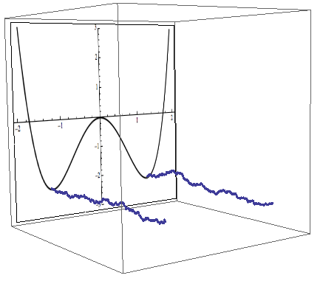
There are many kinds of noise
(e.g., charge noise)
potential energy
time

Slide 17
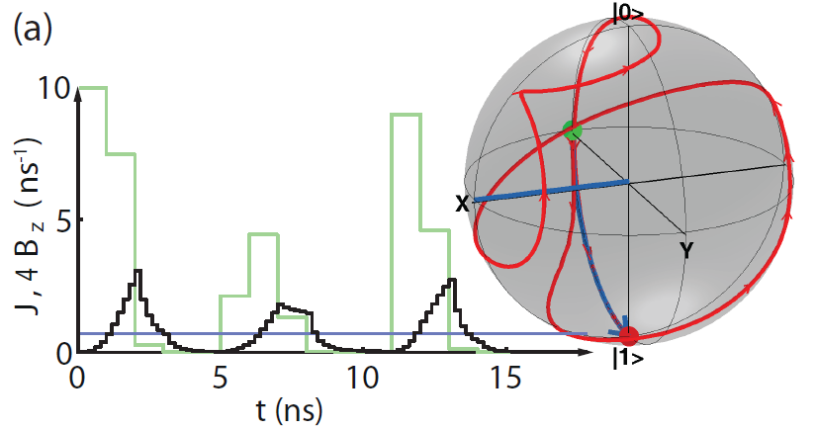
Representative gate
10 to 32 pulse segments
Reminiscent of Rabi, but more fine structure.
1 - F ≈ 0.2 % typical
=> Good gates exist, but can these complicated pulses actually be tuned?

Slide 18
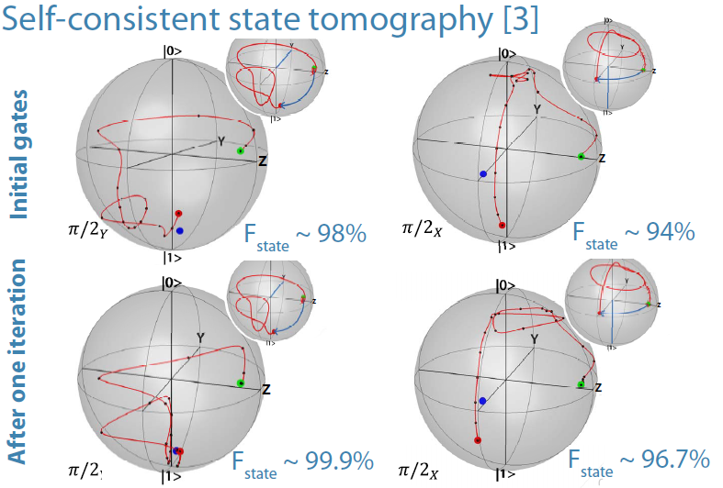
First experimental steps – Pascal Cerfontaine and Hendrik Bluhm
Experimental trajectory reconstructed via self-consistent state tomography (Takahashi et al, PRA 2013).

Slide 19
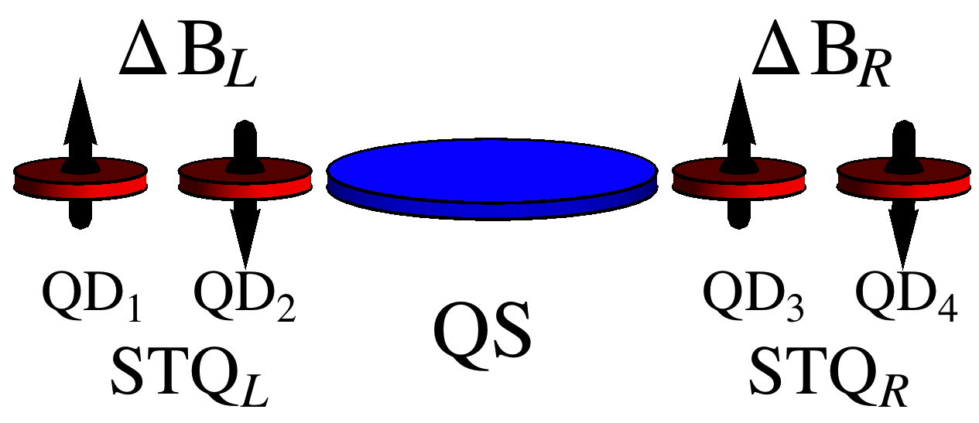
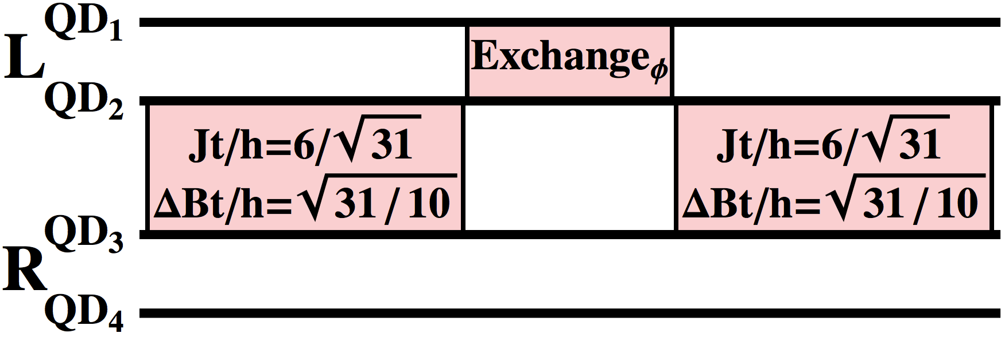
Entangling operation of STQs
singly occupied: exchange
Mehl & DiVincenzo, PRB 90, 045404 (2014)

Slide 20
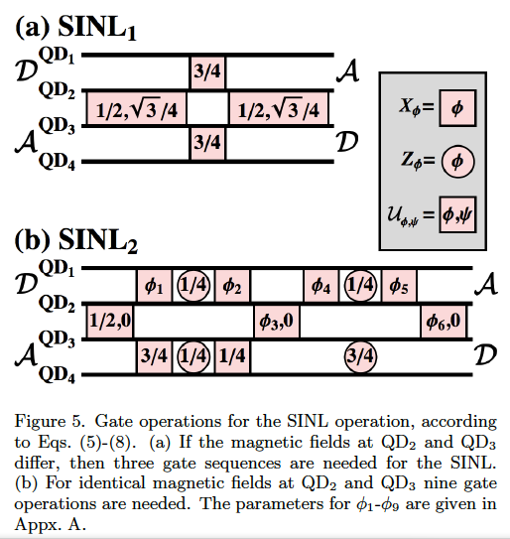
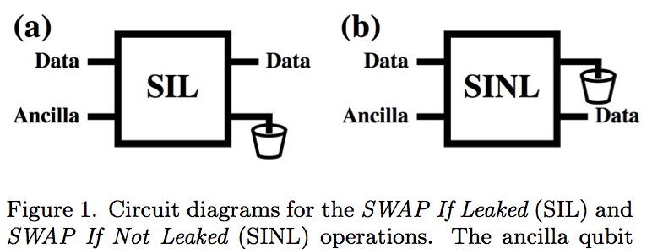
Essential: Leakage Reduction Units
Similar (but not worse than) entangling gates
Mehl, Bluhm, DiVincenzo, in preparation

Slide 21
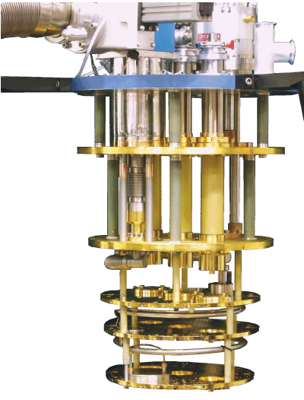
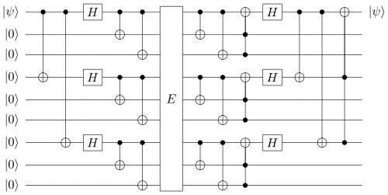
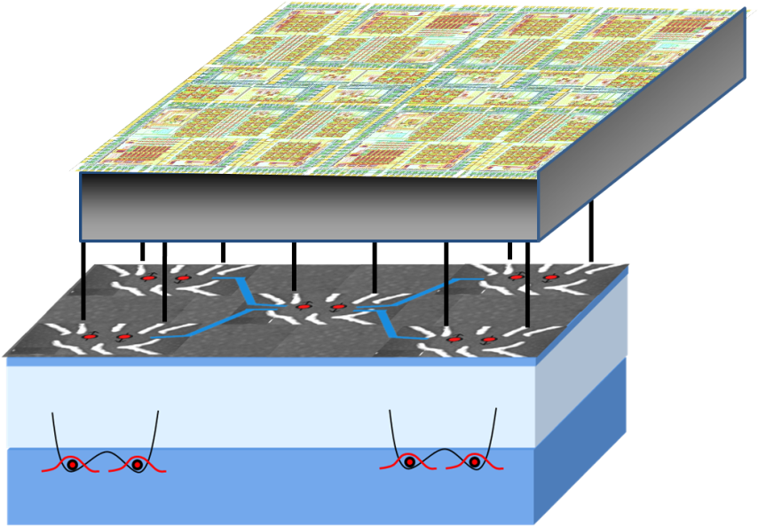
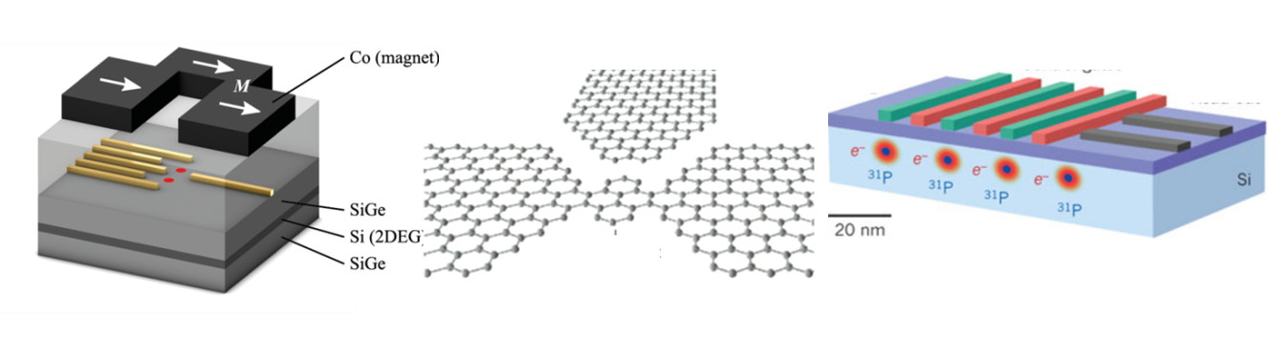
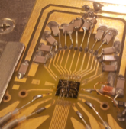
Vision: Scalable architecture
Needed: quantum information theorists

Slide 22
Case study:
Back to UCSB/Google

Slide 23
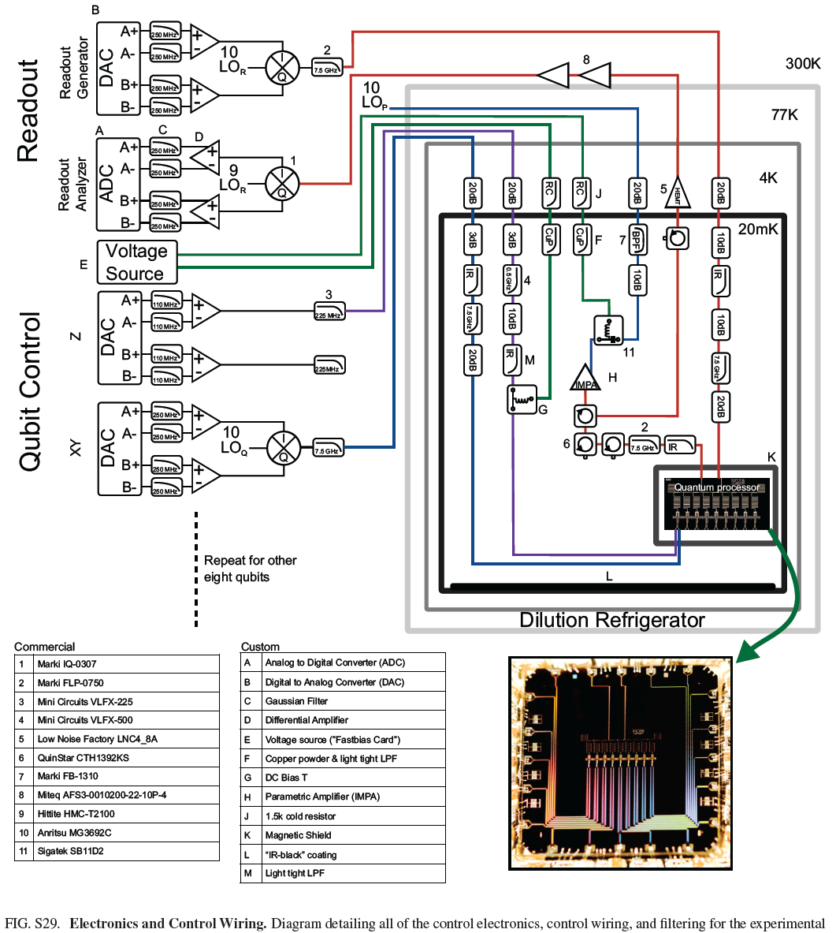
Classical control: 23 control wires for the 9 qubits!

Slide 24
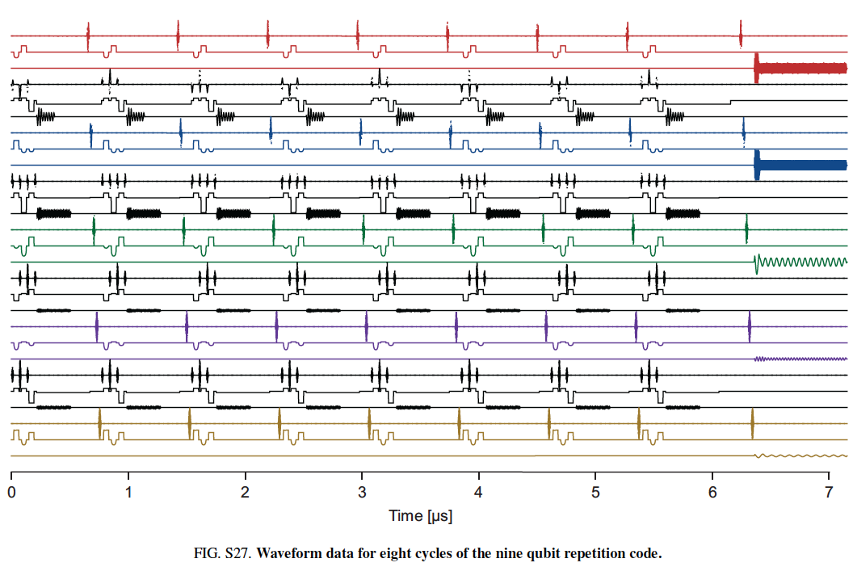
Waveforms of classical signals going to the dilution refrigerator
10 kW power consumption

Slide 25
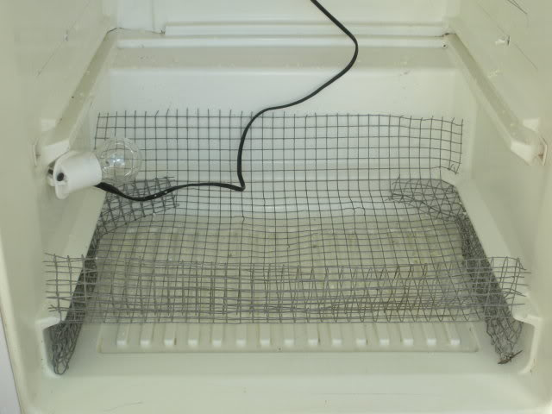
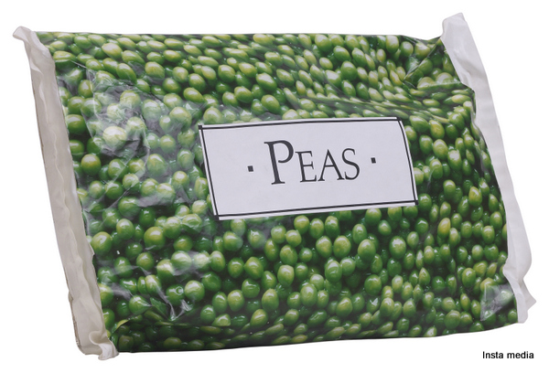

Slide 26
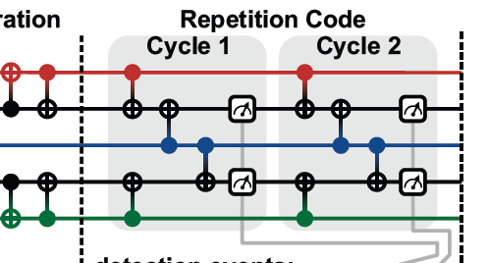
Final observation on UCSB/Google:
-- Their instinct (also DiCarlo, TU Delft) is to report error rates of full
Cycles; focus is not on individual gate errors

Slide 27
An architecture to do surface code operations without using the circuit model
4 “transmon” qubits antenna coupled to cubical electromagnetic cavity
DiVincenzo & Solgun, New J. Phys. 2013

Slide 28
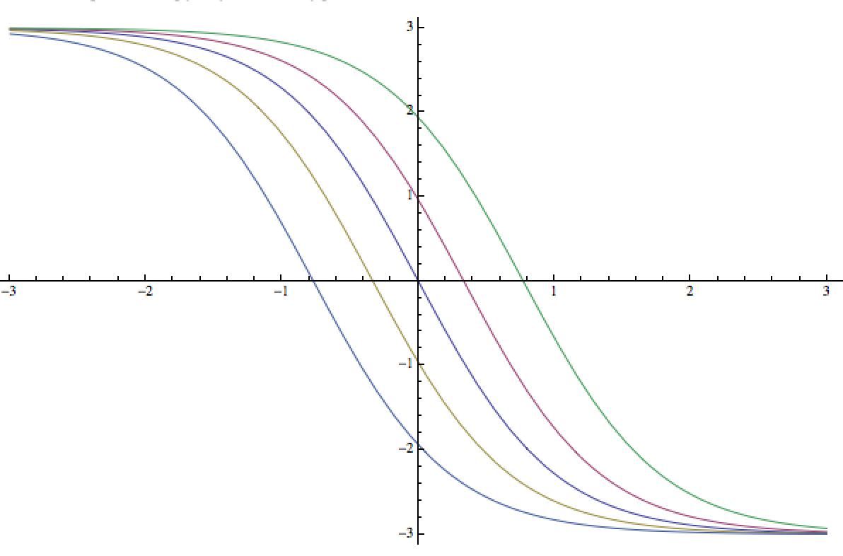
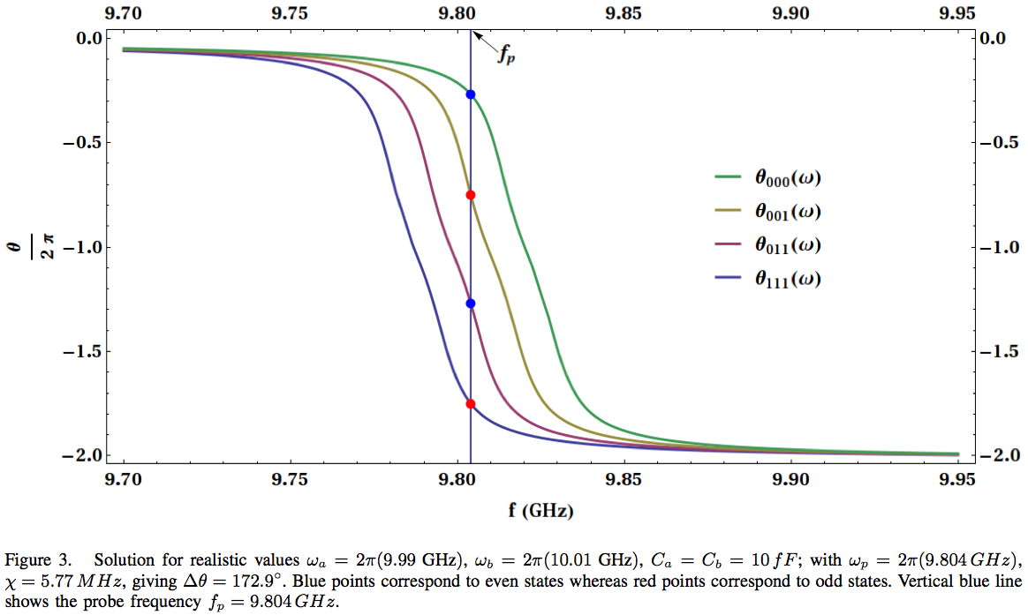
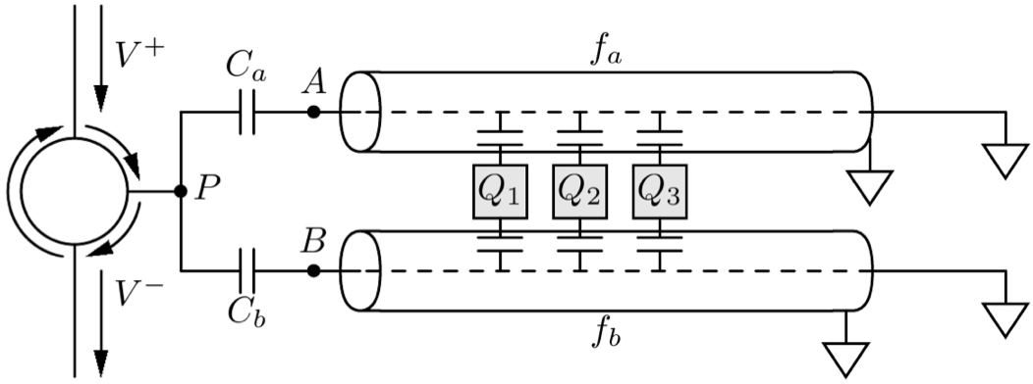
Phase shift of signal reflected from cavity vs. frequency
0000 qubit state
0001
0011
0111
1111
θ is the same for all even states (mod 2π)
θ is the same for all odd states (mod 2π)
θ_{even}≠θ_{odd}

Slide 29
“Fibonacci” Levin-Wen Model
Levin & Wen, PRB 2005
v
p
Trivalent Lattice
Ground State
Q_{v} = 1 on each vertex
B_{p} = 1 on each plaquette
Vertex
Operator
Plaquette
Operator
Q_{v} = 0,1
B_{p} = 0,1

Slide 30
“Fibonacci” Levin-Wen Model
Levin & Wen, PRB 2005
v
p
Trivalent Lattice
Ground State
Q_{v} = 1 on each vertex
B_{p} = 1 on each plaquette
Vertex
Operator
Plaquette
Operator
Excited States are Fibonacci
Anyons
Q_{v} = 0,1
B_{p} = 0,1

Slide 31
Vertex Operator: Q_{v}
“Fibonacci” Levin-Wen Model
j
j
i
v
i
v
k
k
All other

Slide 32
Plaquette Operator: B_{p}
on each plaquette
superposition of loop states
b
b
a
i
j
c
a
i’
j’
c
n
p
k
n’
p
k’
f
m
l
d
f
m’
l’
d
e
e
Very Complicated 12-qubit Interaction!

Slide 33
Quantum Circuit for Measuring B_{p}
1
b
b
2
b
b
3
b
b
2
4
b
b
5
b
b
1
8
9
3
6
c
c
7
e
c
c
e
7
p
10
a
e
c
c
e
a
8
12
11
9
a
e
c
c
e
a
6
4
a
e
c
c
e
a
10
5
11
a
e
a
a
e
a
12
d
d
d
d
a
b
b
a
d
d
d
d
F
F
F
F
F’
S
S
F’
F
F
F
F
X
N. Bonesteel, D.P. DiVincenzo, PRB 2012

Slide 34
Gate Count
1
b
b
2
b
b
2
3
b
b
4
b
b
1
3
5
b
b
8
9
6
c
c
7
e
c
c
e
7
p
10
8
a
e
c
c
e
a
9
a
e
c
c
e
a
6
12
11
4
10
a
e
c
c
e
a
11
a
e
a
a
e
a
12
d
d
d
d
a
b
b
a
d
d
d
d
5
F
F
F
F
F’
S
S
F’
F
F
F
F
X
8 5-qubit Toffoli Gates
2 4-qubit Toffoli Gates
10 3-qubit Toffoli Gates
43 CNOT Gates
24 Single Qubit Gates
371 CNOT Gates
392 Single Qubit Rotations
N. Bonesteel, D.P. DiVincenzo, PRB 2012

Slide 35
Outline
Surface codes everywhere (and even color codes)
Various rough approximations of scalability
Attempting to get error & leakage rates under control – example from quantum dot qubits
The highly complex classical world of surface codes – example from UCSB/Google
Outside the gate model – one-shot syndrome measurement
Inside the gate model – Fibonnaci anyons

Slide 37
What’s QEC for Solid State Physics?
“Surface code” is on the lips of many a solid-state device physicist these days. I will document this phenomenon with some examples, from the commonplace (CNOT to ancillas, then measure) to the more recondite (direct parity measurement, intrinsic leakage of DFS qubits). I will give some examples from current work in quantum-dot qubits. Mighty efforts are underway to improve laboratory fidelities, which are however neither quantitatively nor methodologically complete. Leakage reduction units are starting to come over the horizon, but QEC could probably help more with this. There are correspondingly mighty plans on the drawing board to collect and process all the data that the surface code implies. I will show what small parts of these plans have come to fruition; QEC should also do some work to determine what is really the best thing to do with this avalanche of data, when it comes. I will also touch on some examples where solid-state physics definitely gives back to QEC, with Fibonacci quantum codes being one example.

Slide 38
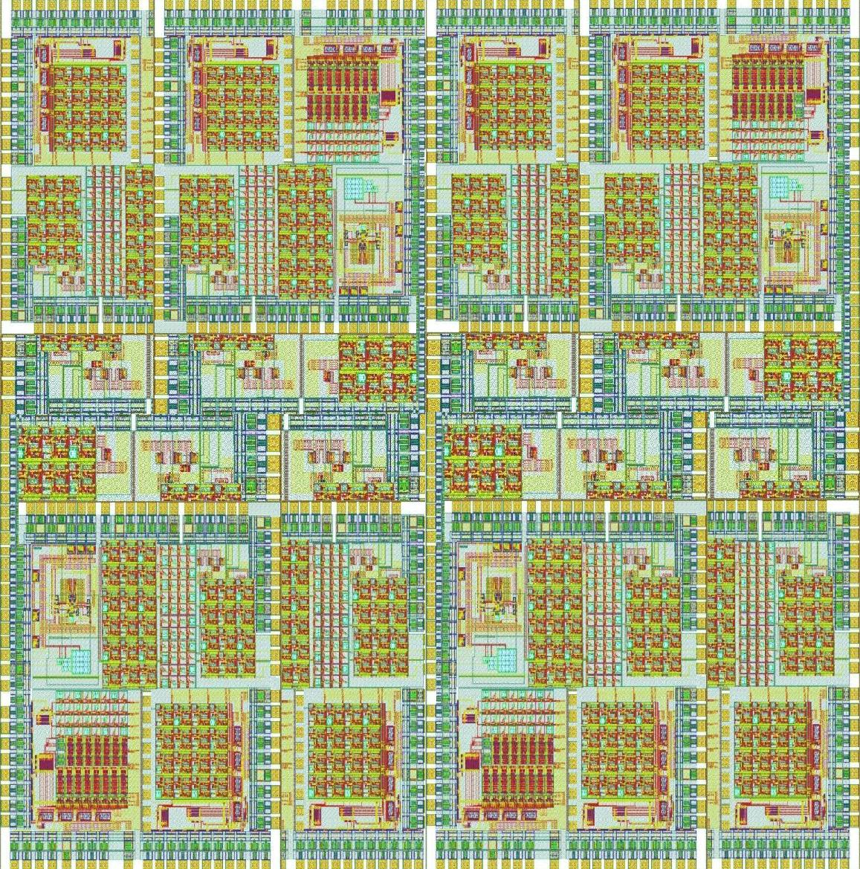
Project group A
Quantum information architectures
Error correction
A1-3
Interaction between qubits
SAW spin transfer (A4)
Semiconductor Josephson elements (A5-7)
 | Project | Principal Investigator(s)
A1 | Quantum memory in circuit-QED | Prof. B. Terhal
A2 | Qubit architectures for Fibonacci quantum computation | Prof. D. DiVincenzo
A3 | Quantum dynamics of Andreev states | Dr. G. Catelani
A4 | Quantum computation with Majorana fermions | Prof. F. Hassler
A5 | Topological quantum memories and Projected Entangled Pair States | Prof. N. Schuch
A6 | Quantum dot qubit architectures with surface acoustic waves | Prof. D. DiVincenzo
A7 | Nanoscaled Josephson transistors for quantum information circuits | Prof. J. Knoch, Prof. T. Schäpers

Slide 39
“Fibonacci” Levin-Wen Model
Levin & Wen, PRB 2005
v
Trivalent Lattice
Vertex
Operator
Q_{v} = 0,1

Slide 40
“Fibonacci” Levin-Wen Model
Levin & Wen, PRB 2005
v
p
Trivalent Lattice
Vertex
Operator
Plaquette
Operator
Q_{v} = 0,1
B_{p} = 0,1

Slide 41
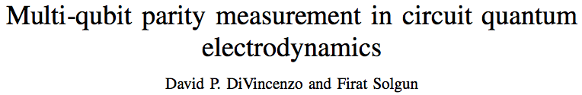
arXiv:1205.1910
No gate action among the three qubits
Three qubits coupled dispersively to each of two nearly degenerate resonant modes
Measurement by reflectometry: tone in at + port, detect phase of tone out at – port
Designed as quantum eraser: measures only ZZZ (parity)

Slide 42
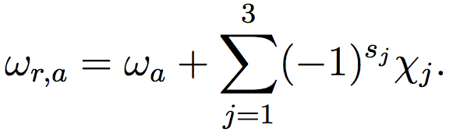
A two-resonator device for measuring the parity of three qubits:
χ=g²/Δ
s₁, s₂, s₃ are the states of the three qubits (0,1)
χ_{i} is dispersive shift parameter
Dispersive coupling is the same for each qubit
and the same on both resonators (a and b)

Slide 43
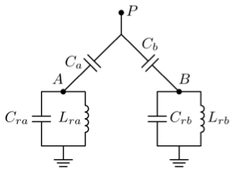
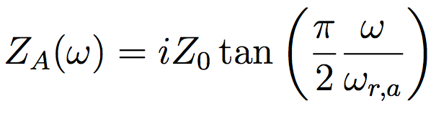
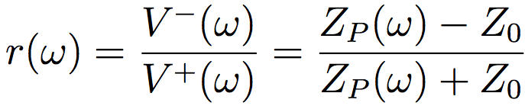

Wave impedance
“looking into” port A
(transmission line theory)
(Z₀=50Ω)
Reflection coefficient of full structure
NB

Slide 44
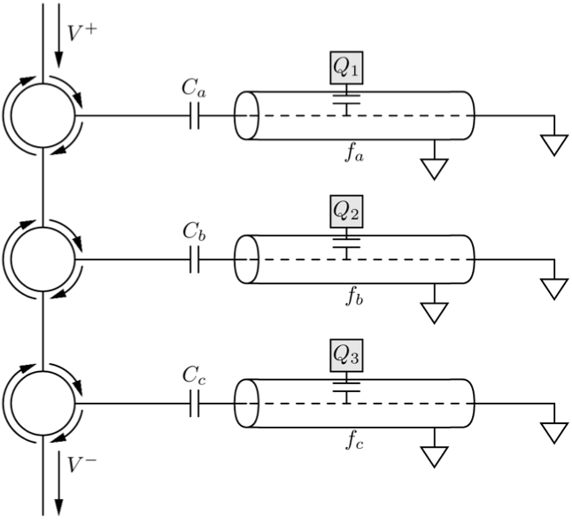
Alternative solution of Mabuchi and coworkers

Slide 45
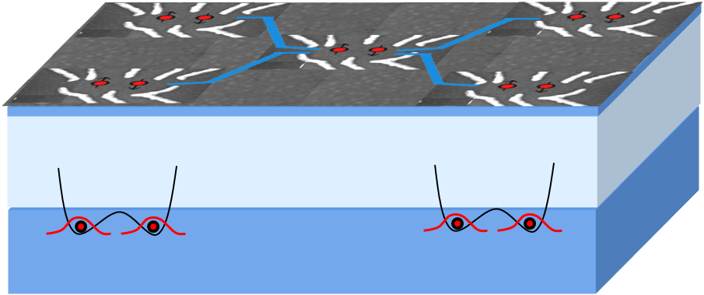
Project group B
Semiconductor multi-qubit circuits
Transistors optimized for cryogenic control
Control system
ZEA-2, FZJ
Engineering (B3)
Optical interface
to qubits: B7,B8
Qubits
Scalable multi-qubit circuits: B1
Material optimization: B2
Decoherence: B4-B6
Physics

Slide 46
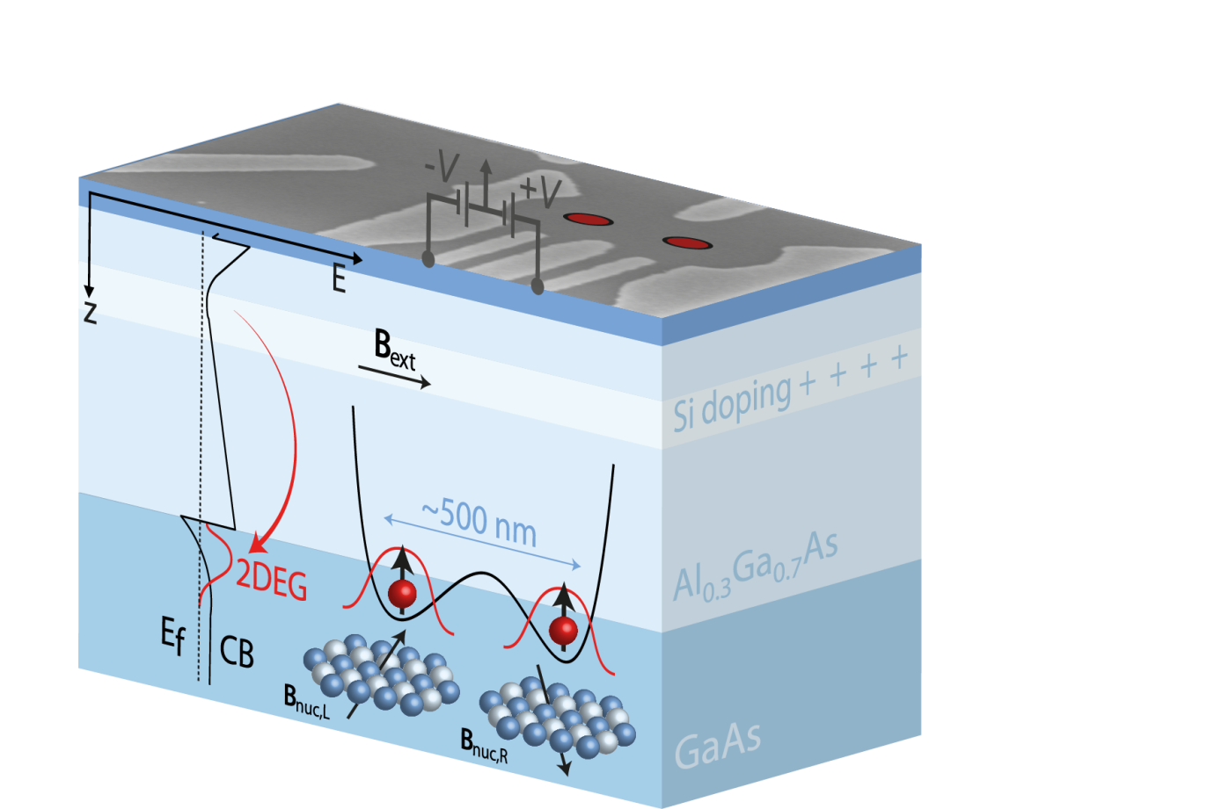
High fidelity gates
Well-established spin qubits,
key operations demonstrated
Detailed knowledge of
dephasing characteristics
Key requirement:
Gates with error rate <~ 10⁻⁴
What fidelities can be reached
in the face of realistic hardware
constraints?
How can systematic errors be
eliminated?

Slide 47
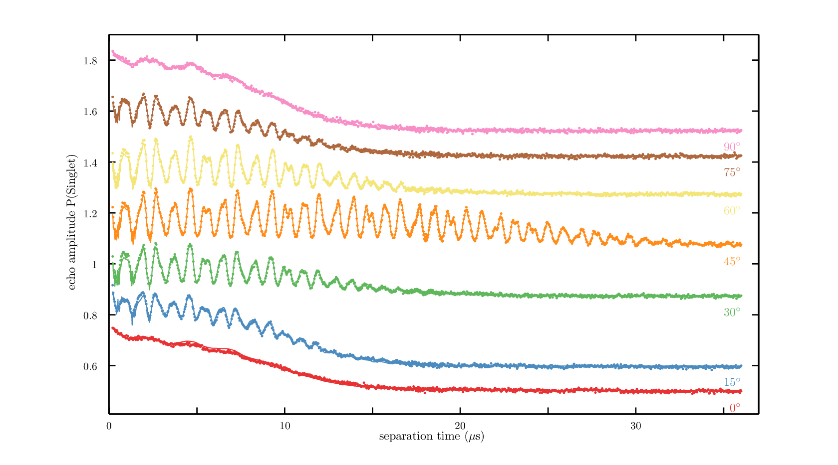
Dephasing due to nuclear spins
New insights – Pronounced effects on Hahn echo from:
Nuclear quadrupole splitting
g-factor anisotropy
ΔB_{z}
J
90°
75°
60°
echo amplitude
45°
30°
15°
0°
0
10
20
30
evolution time (µs)

Slide 48
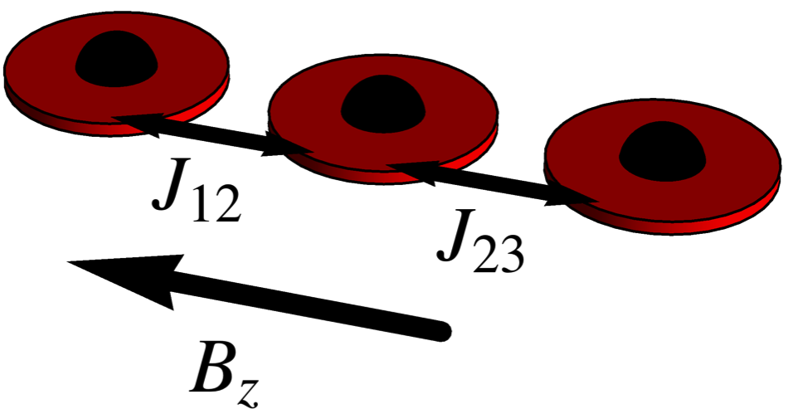
Triple Quantum Dot Qubit
exchange-only qubit
PRB 87, 195309 (2013)

Slide 49
Triple Quantum Dot Qubit
exchange-only qubit
PRB 87, 195309 (2013)

